Slide 1
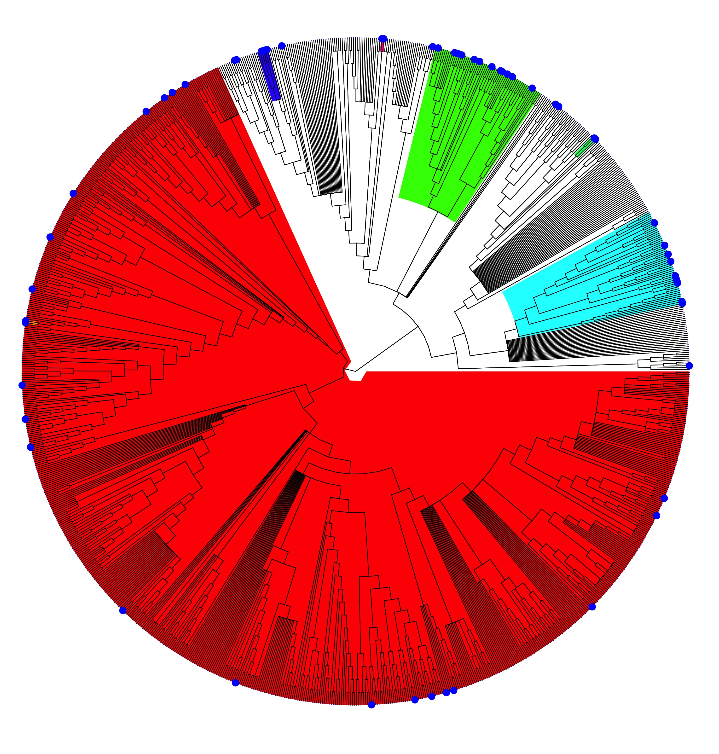
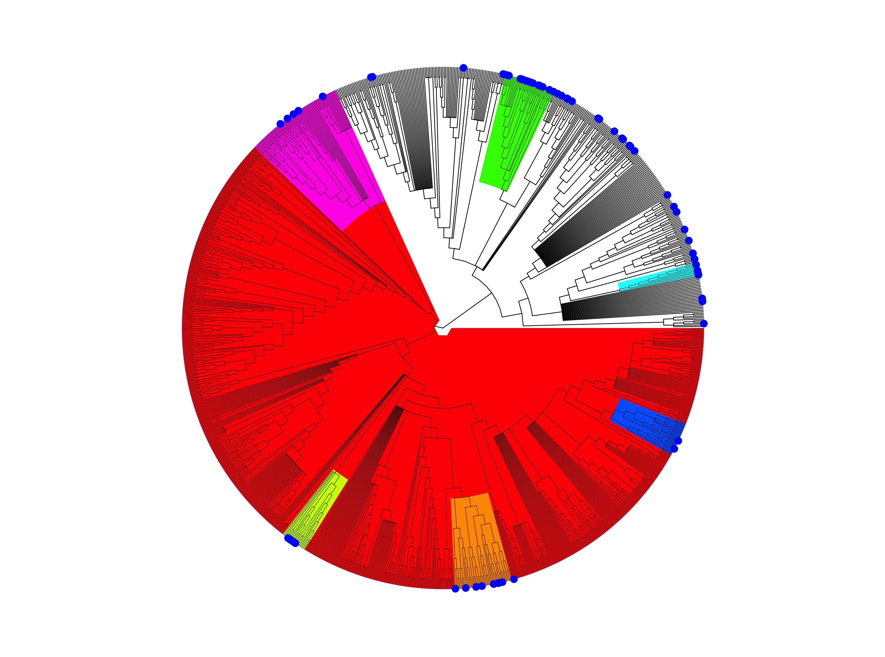
Sampled
Figure 1: Phylofactorization of sampling across the full bat phylogeny. Phylofactorization of the full bat phylogeny from the Open Tree of Life by a fisher test on the fraction of species sampled for either a Henipavirus of Filovirus. The first phylogenetic factor for both filo and henipaviruses identifies the clade Yangochiroptera, which has been under sampled for these viruses compared to the paraphyletic remainder. The following 6 clades have been heavily sampled for either a filovirus or henipavirus.
Yangochiroptera | p=0.027
Carollia | p=1
Pteropus | p=0.67
Pteropodidae | p=0.21
Rhinolophus | p=0.19
Eidolon | p=1
Hipposideros | p=0.67
Henipavirus
Yangochiroptera | p=0
Myotis | p=0.21
Miniopterus | p=0.28
Pteropodidae | p=0.4
Emballonuroidea | p=0.075
Rhinolophus | p=0.56
Pipistrellini | p=0.087
Filovirus

Slide 2
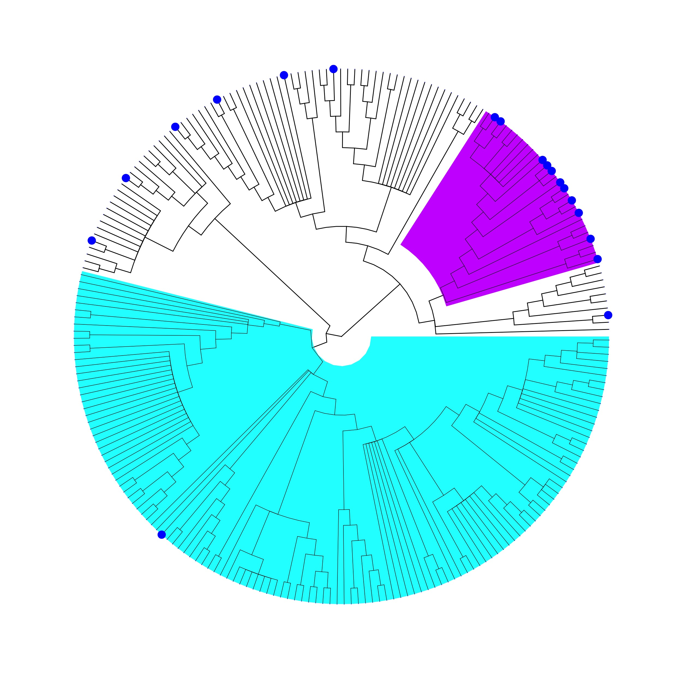
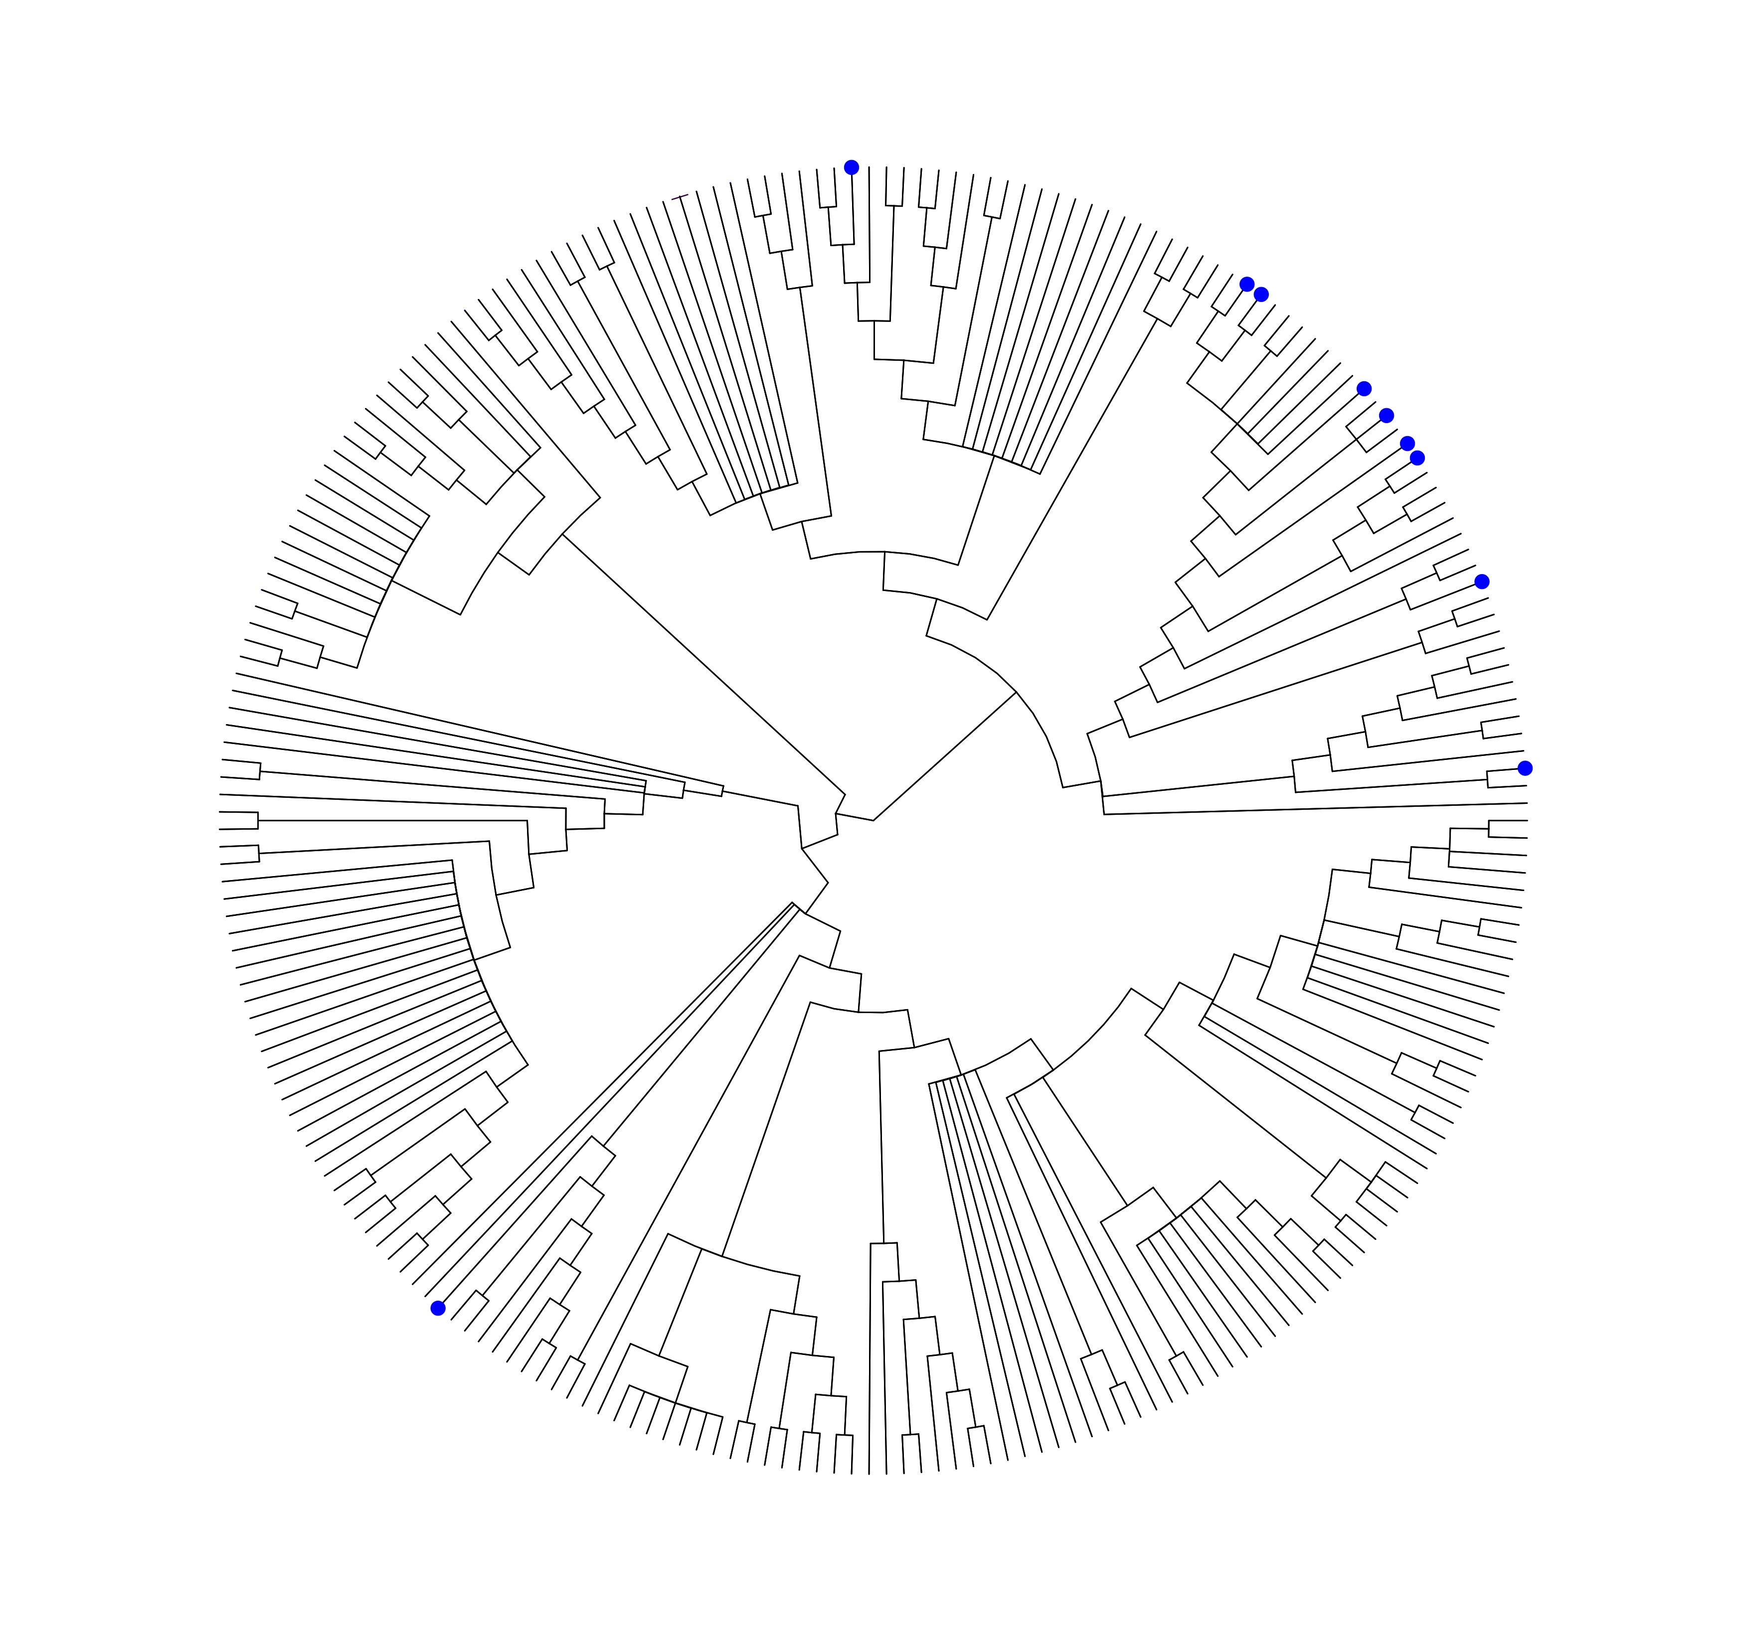
Sampled
Ab or PCR Positive
Pteropodidae | p=0.41
(Pteropodinae & Macroglossinae)
Vespertilionoidea | P=.001
Filovirus
Figure 2: Phylofactorization of the African bat phylogeny.
Sampled: Phylofactorization of the African bat phylogeny from the Open Tree of Life by a fisher test on the fraction of species sampled for Filoviruses. The first phylogenetic factor is the Pteropodidae which have been heavily sampled compared to the paraphyletic remainder. The African Vesper bats have been under sampled compared the paraphyletic remainder. Ab or PCR Positive: Phylofactorization by a fisher exact test on the fraction of African bat species either Ab+ or PCR+ for filoviruses. No phylogenetic factor was identified as being more or less likely to be Ab+ or PCR+.

Slide 3
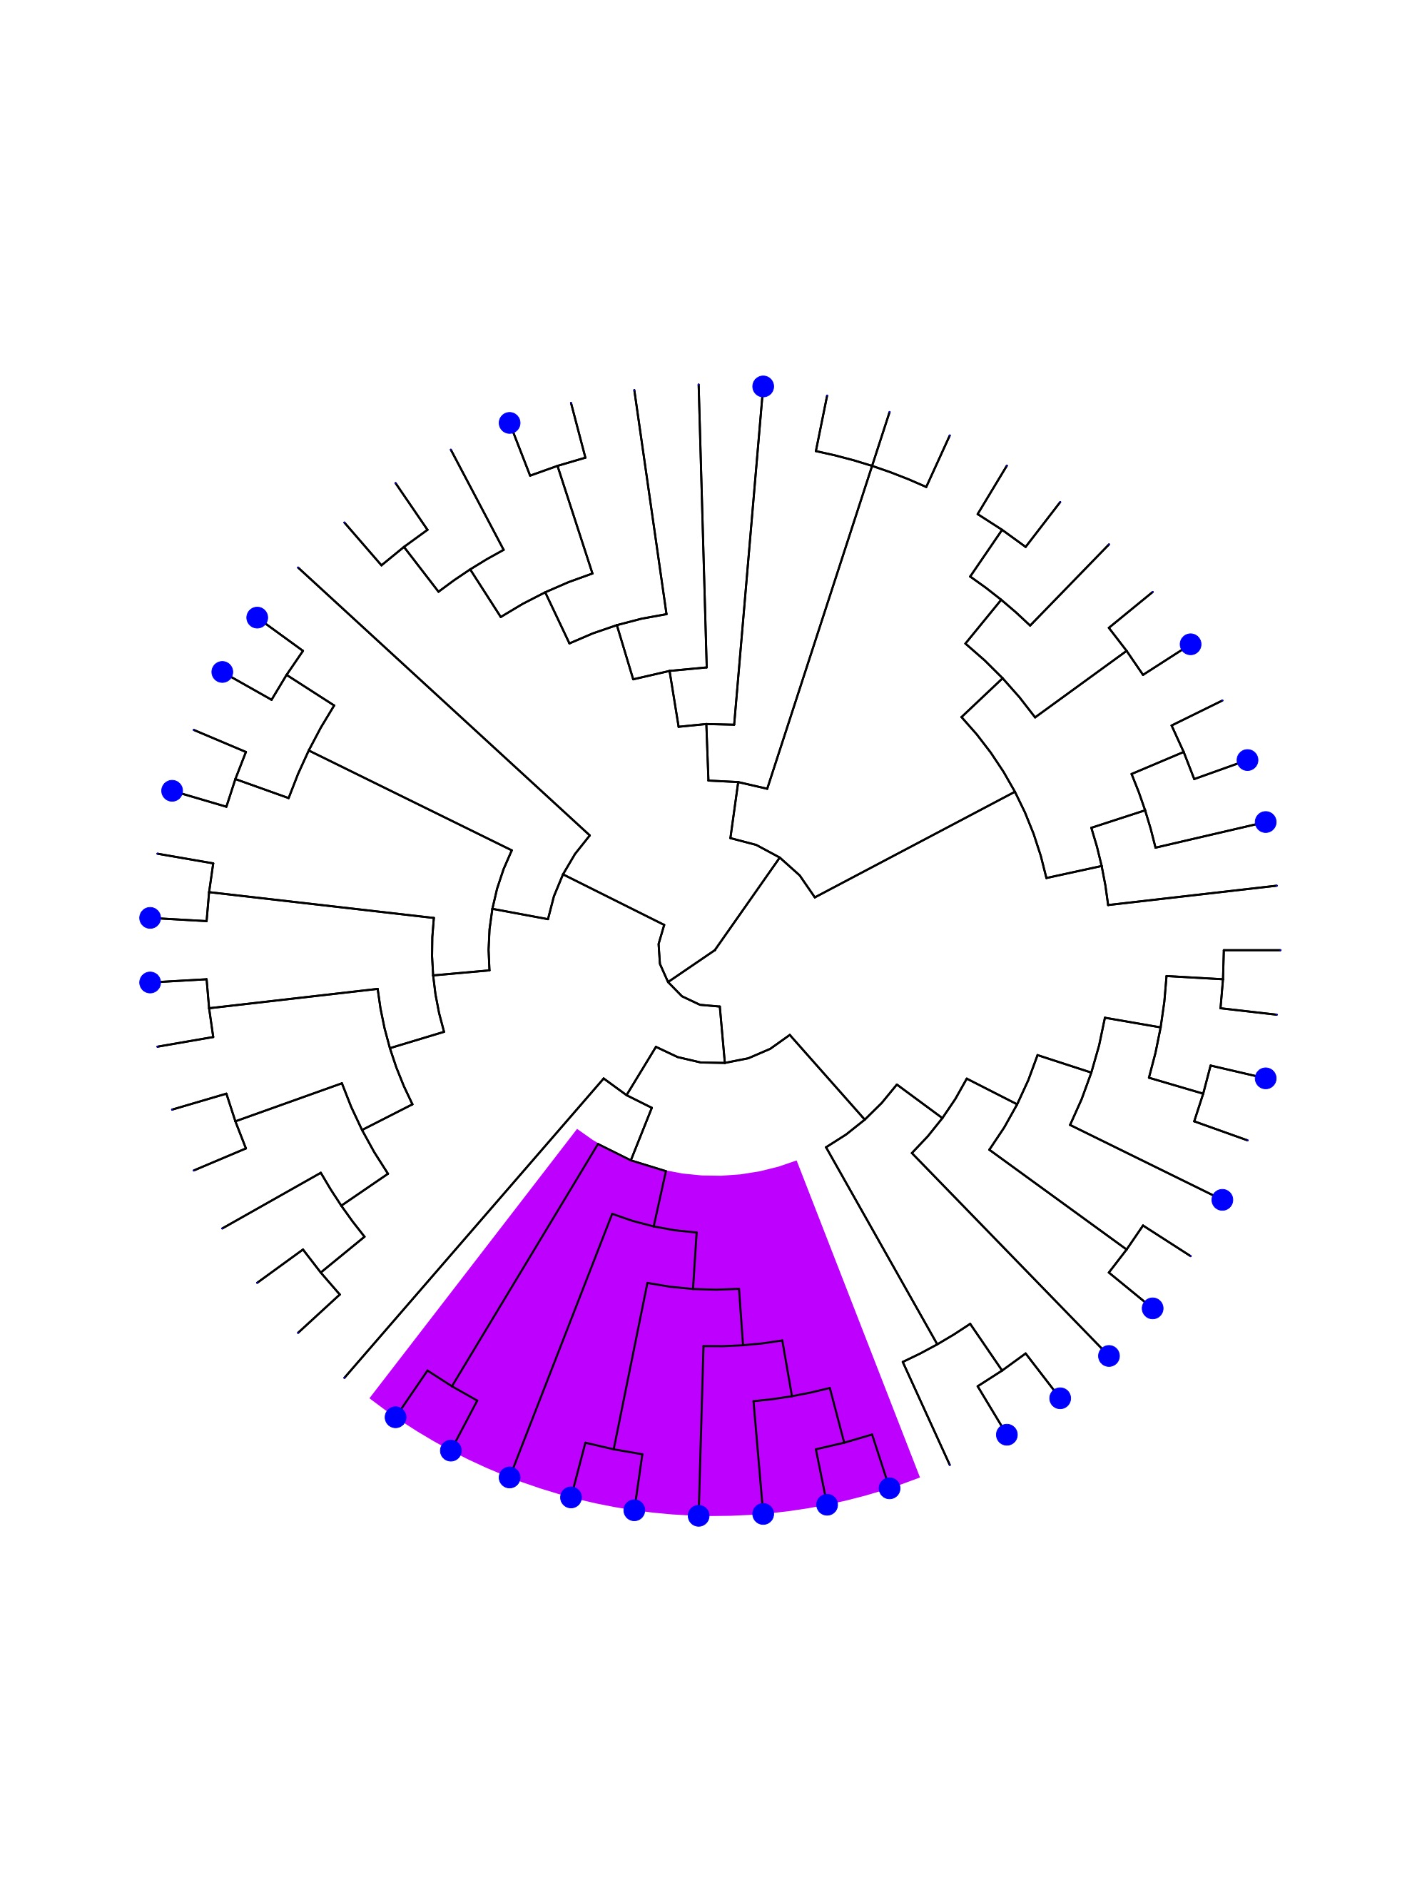
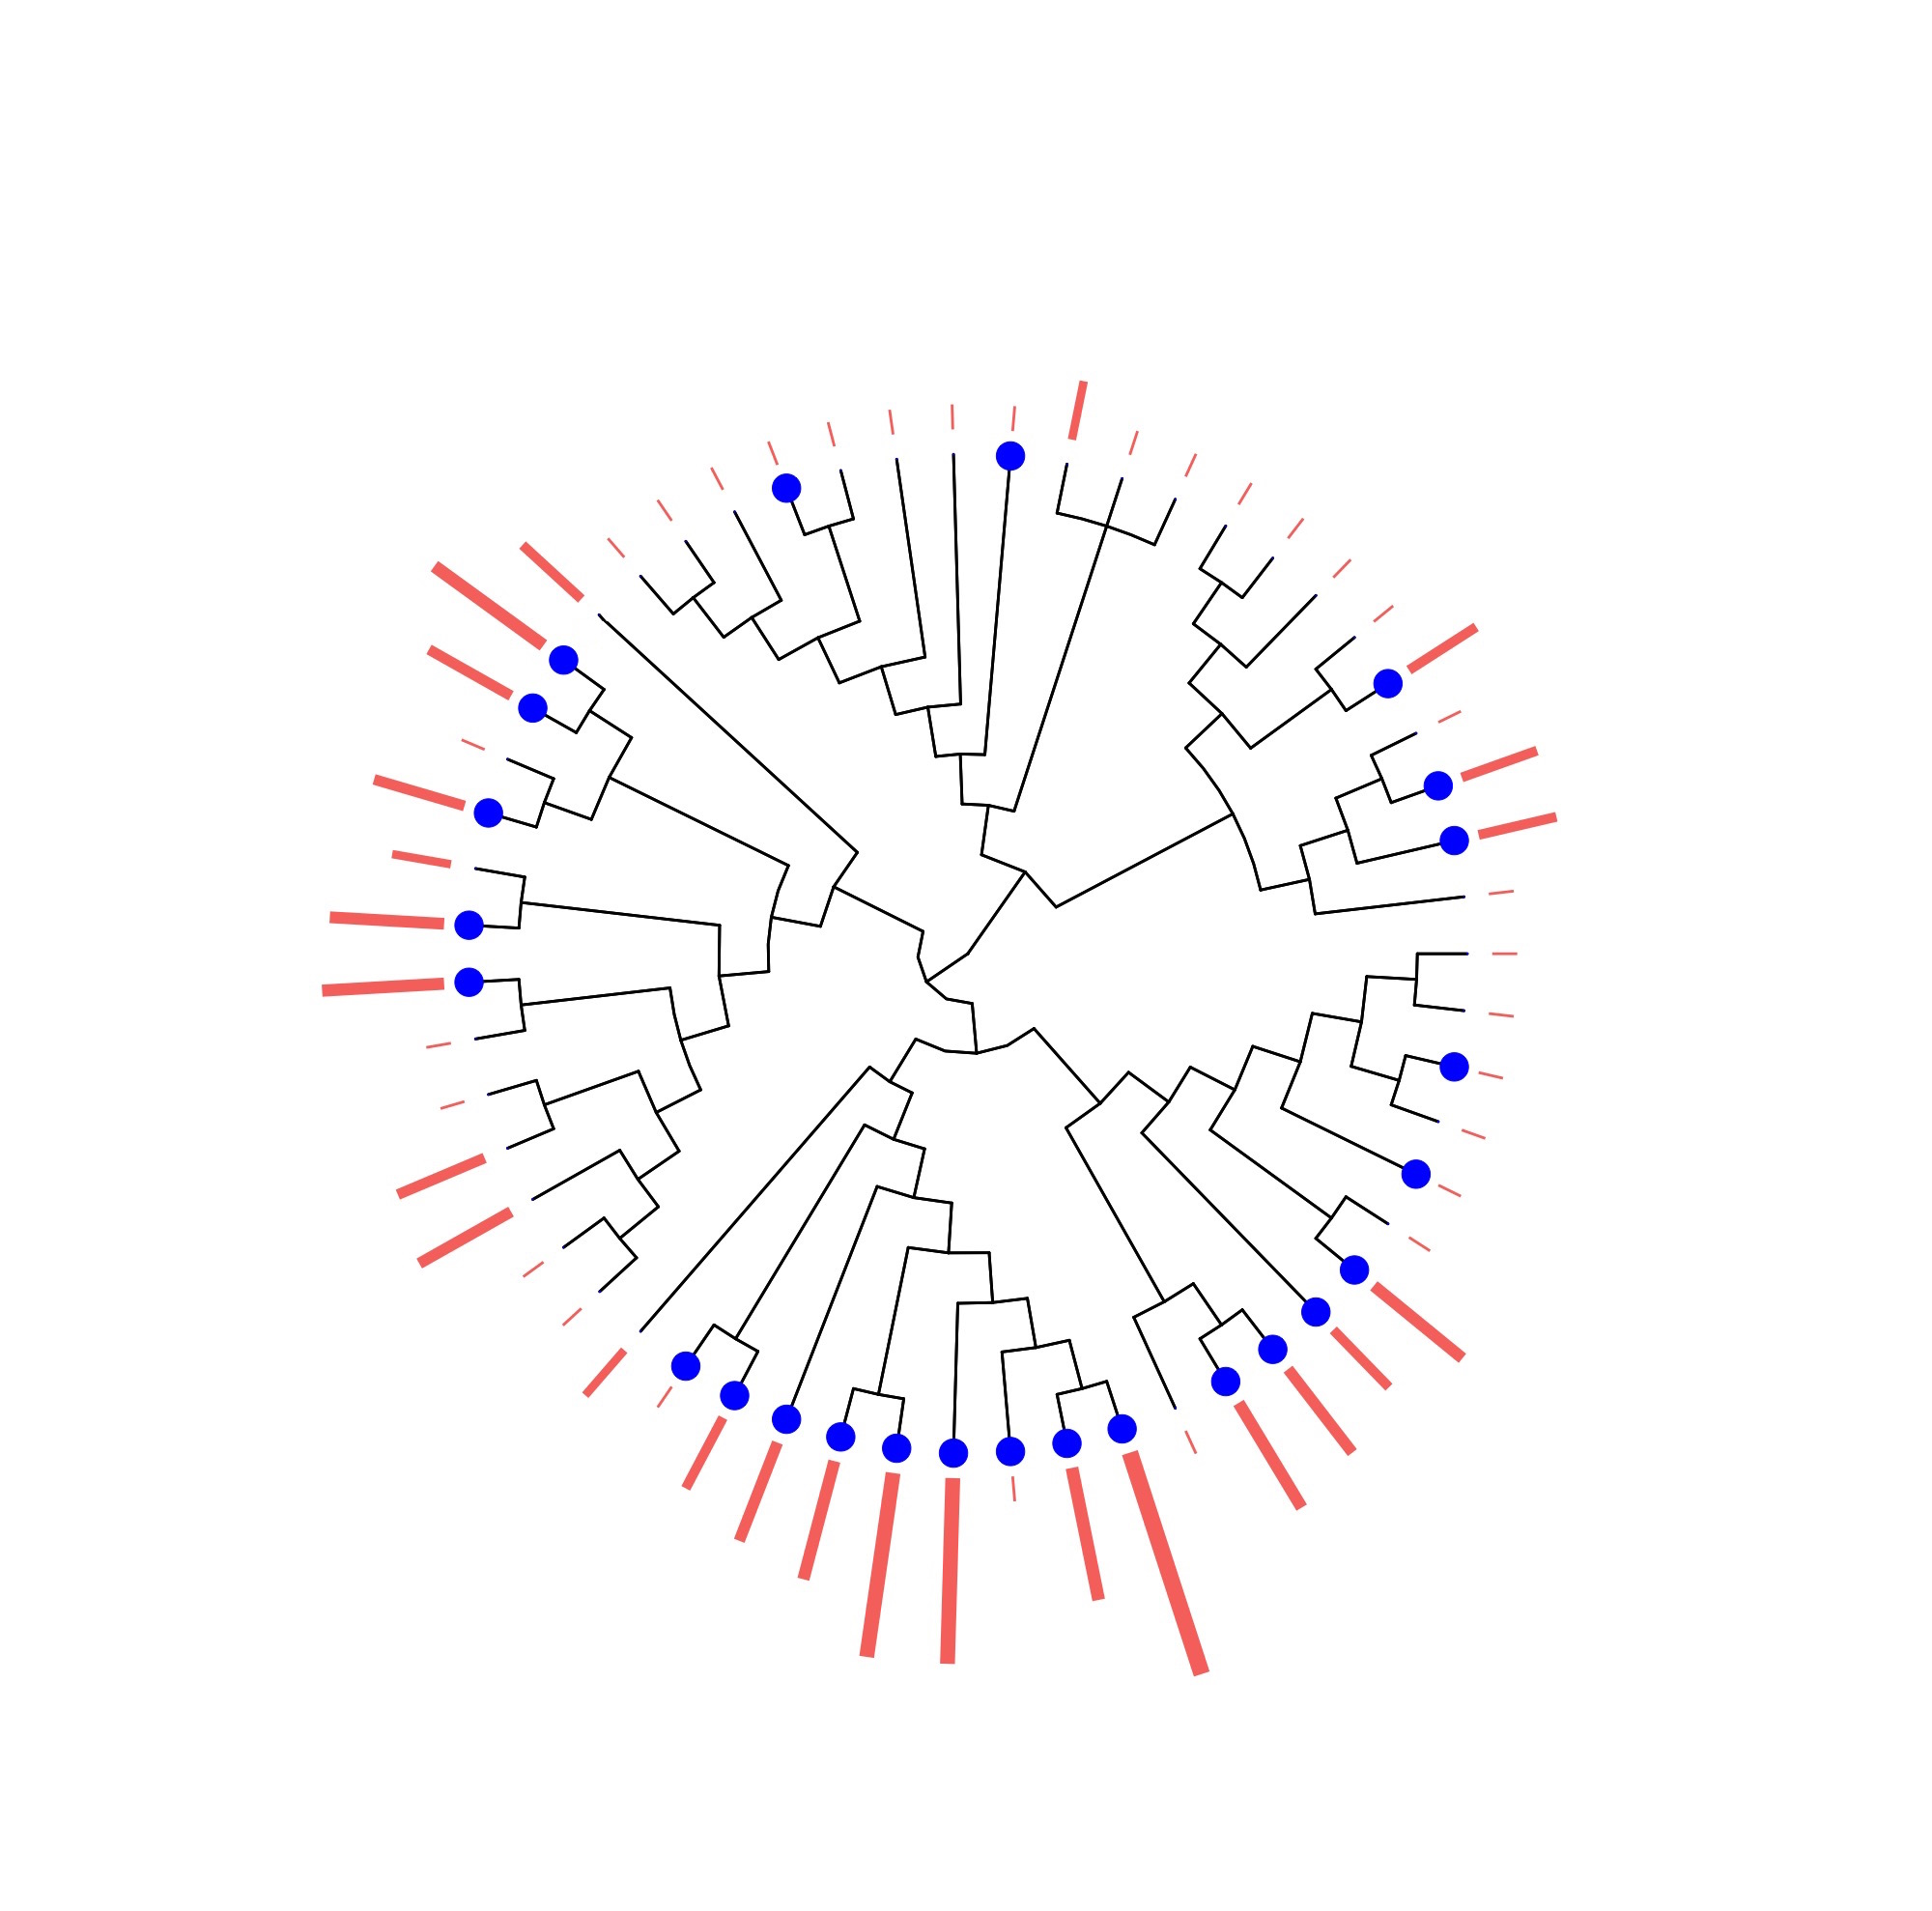


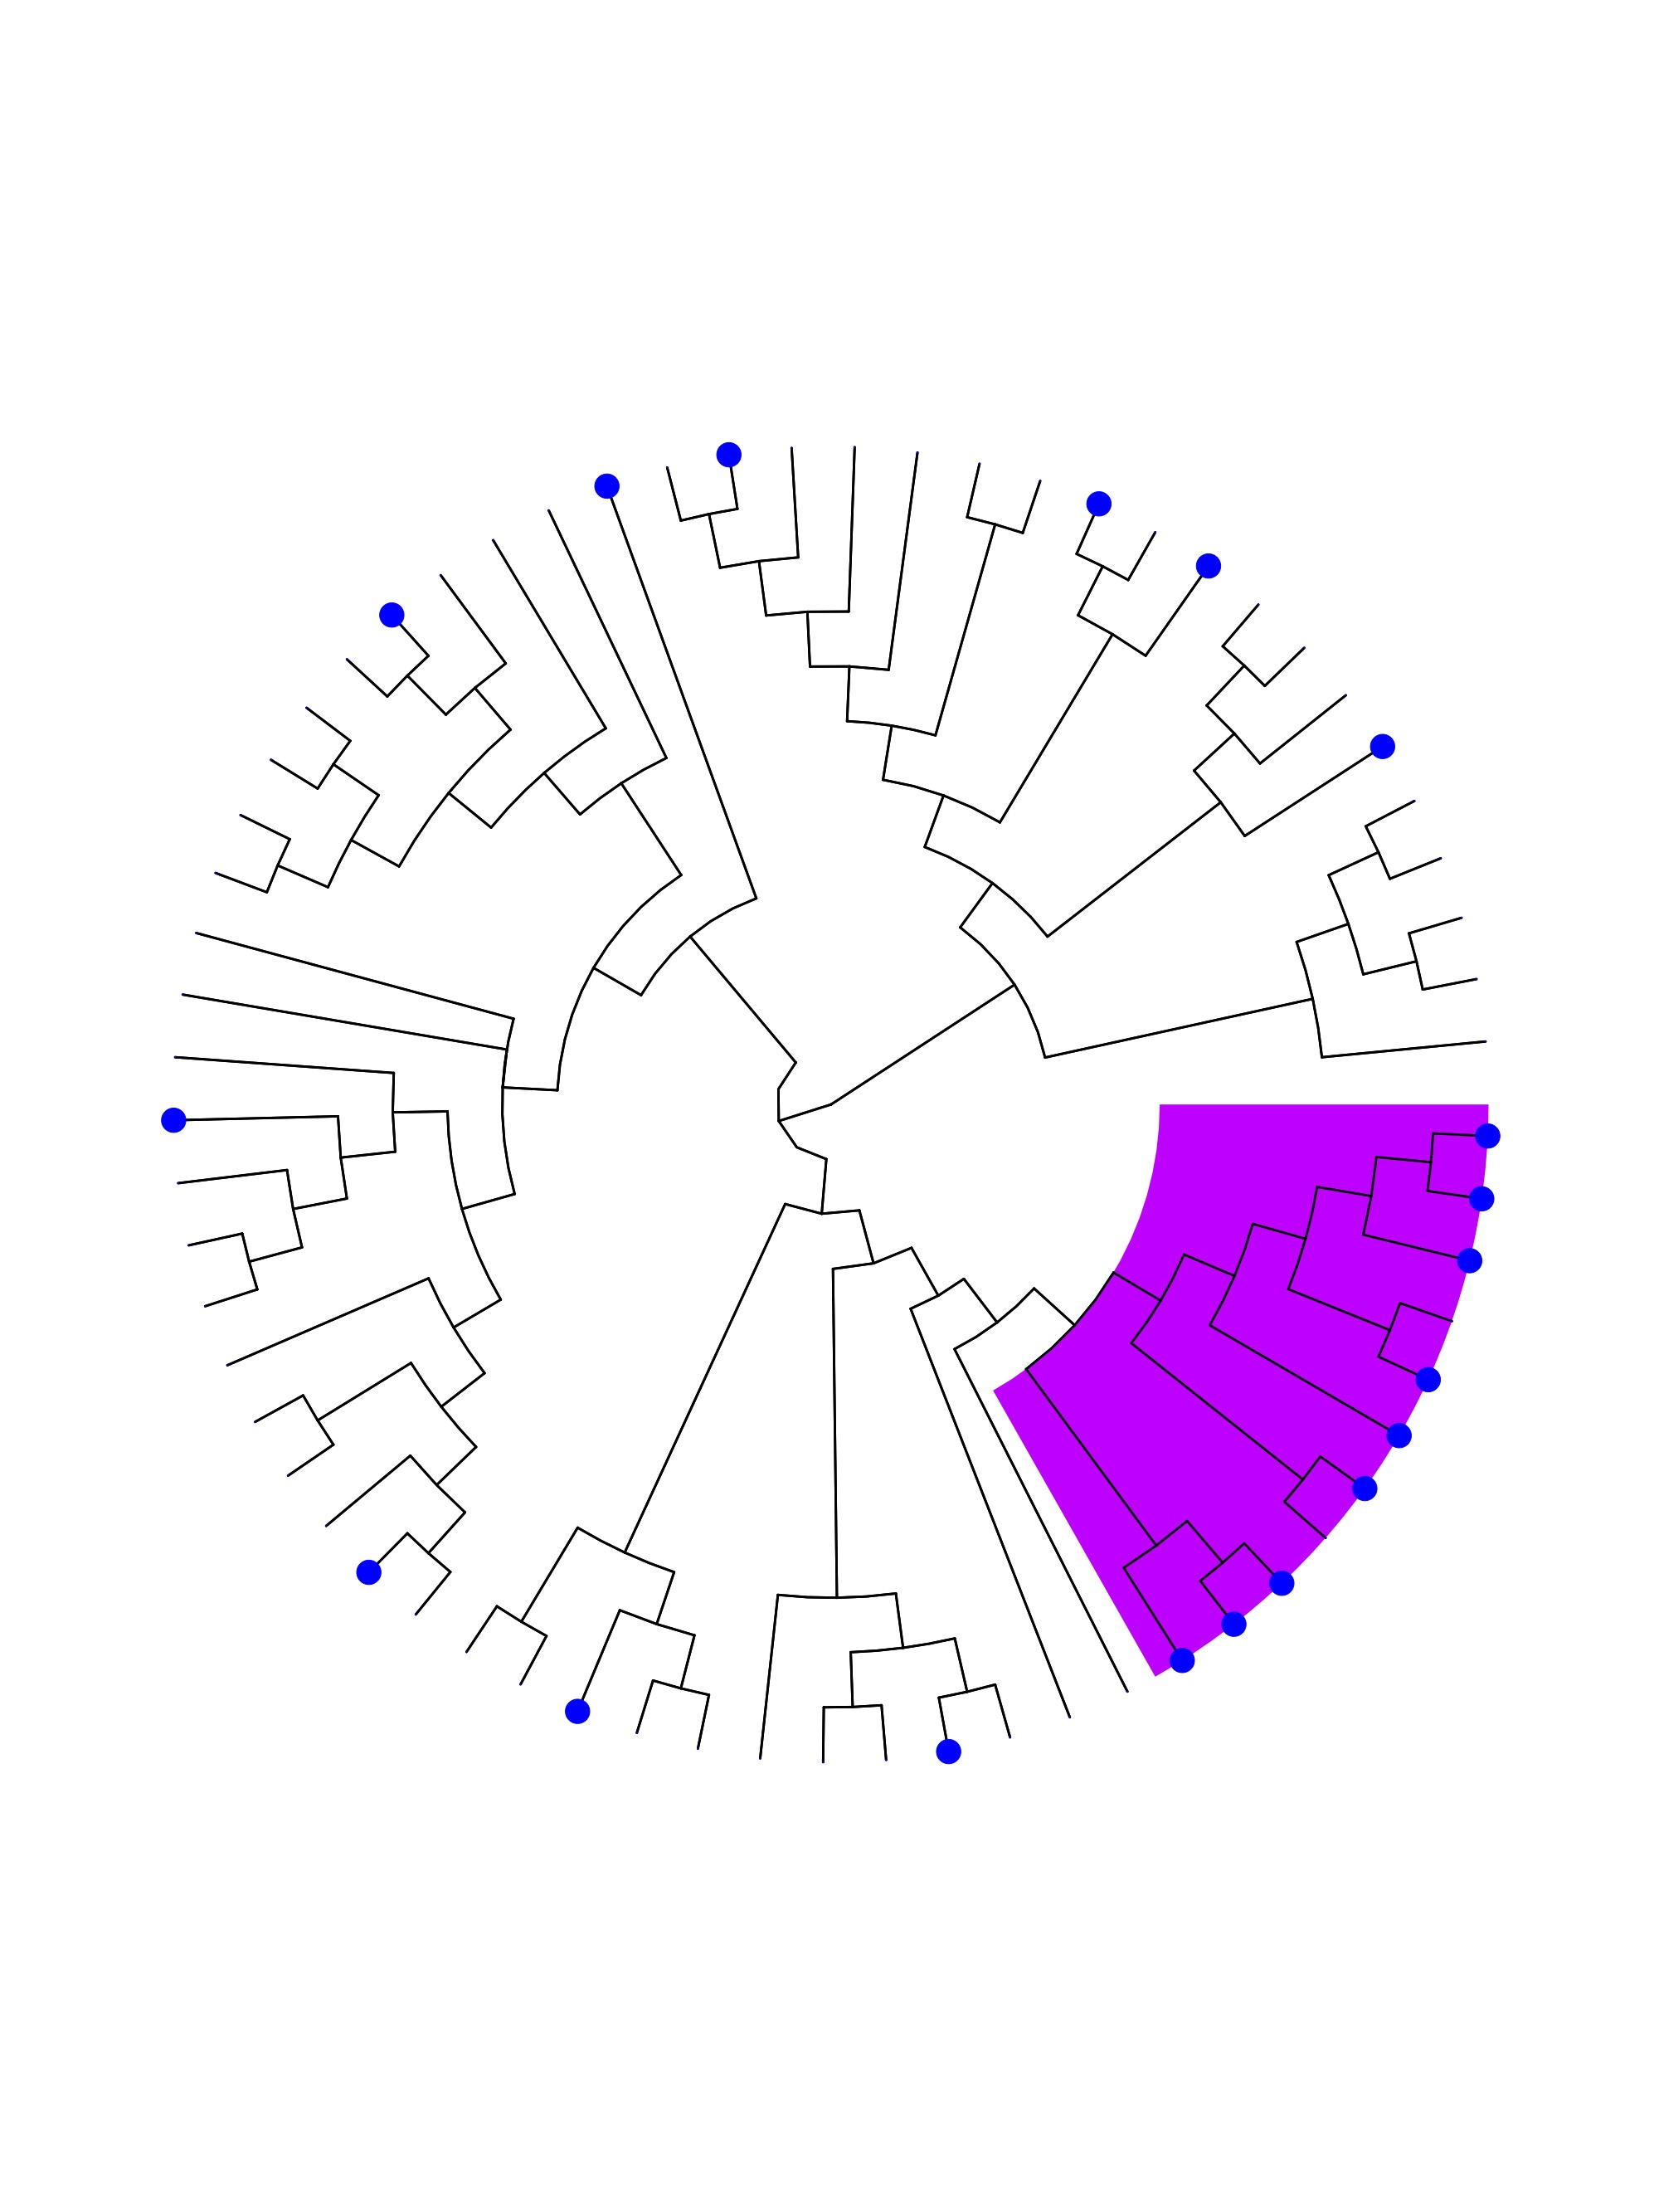
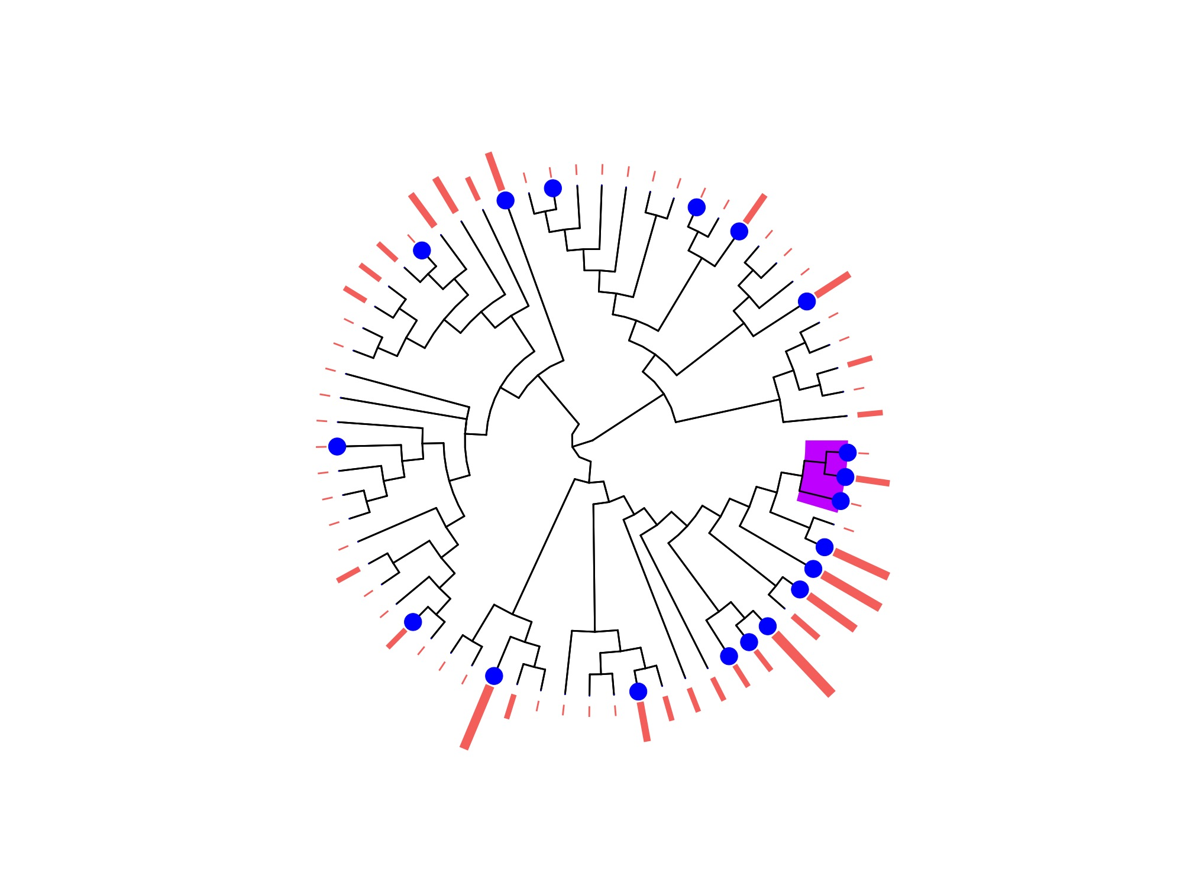
Ab or PCR Positive
Ab or PCR Positive (Controlling for Sampling Effort)
Sampling effort
Henipavirus
Pteropodinae (Pteropus and Eidolon) | P=1
Sampling effort
Pteropodinae(Nanonycteris veldkampii, Micropteropus pusillus,Epomophorus gambianus) | P=1
Filovirus
Pteropodinae | P=.82
Figure 3: Phylofactorization of Ab+ or PCR+ positivity from all sampled bats. Phylofactorization of the bat phylogeny from the Open Tree of Life, excluding bats that have not been sampled, by generalized phylofactor regression. The outcome variable of interest is evidence of Ab+ or PCR+ . Sampling effort was modeled using the natural log. Orange bars are visual representation of 1 + natural log(sampling effort).

Slide 4
A
Fig 4. Sampling & Reporting Strategy
A schematic displaying a theoretical change in seroprevalence over the course of a year. Colored regions represent sampling schemes present in filovirus/henipavirus literature.
B. Breakdown of sampling schemes present in literature. Includes mean time (in days) and standard deviation over which studies pooled multiple sampling events into single estimate.
(NOTE TO DC FROM DC: update the table)
B

Slide 5
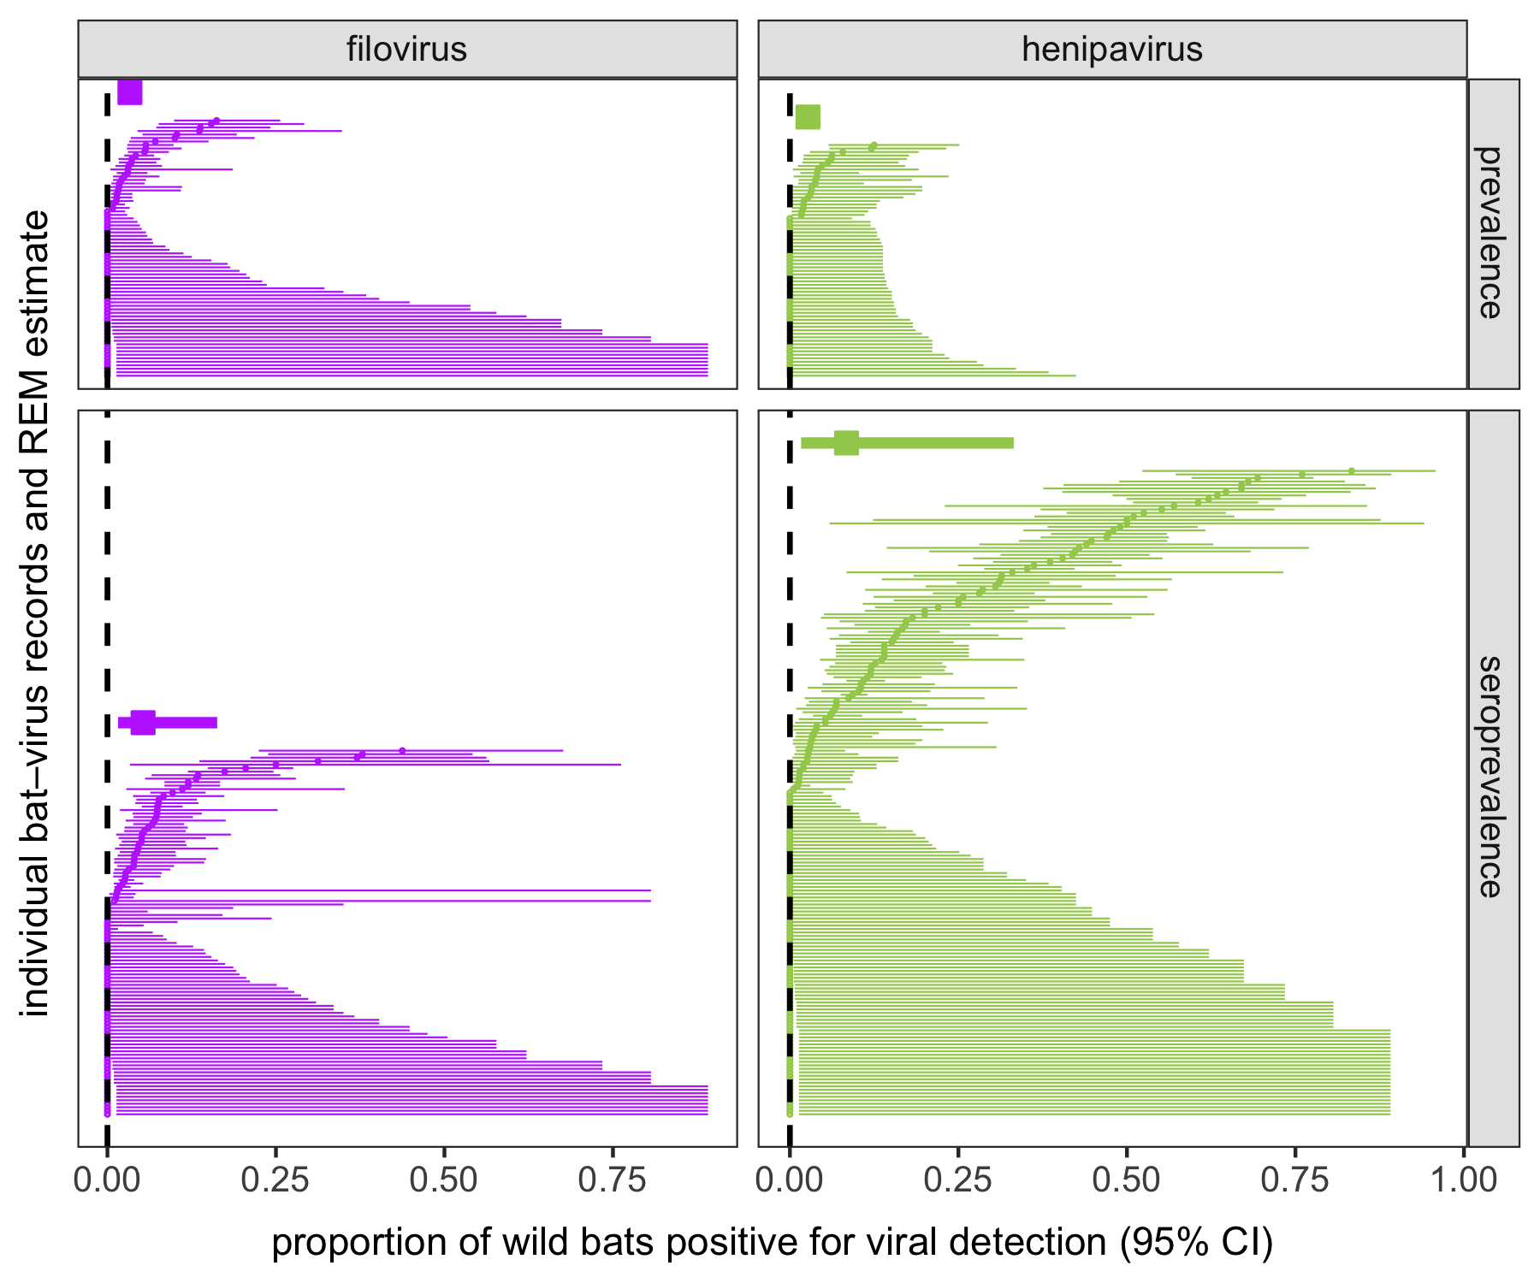
Fig 5/Y.

Slide 6
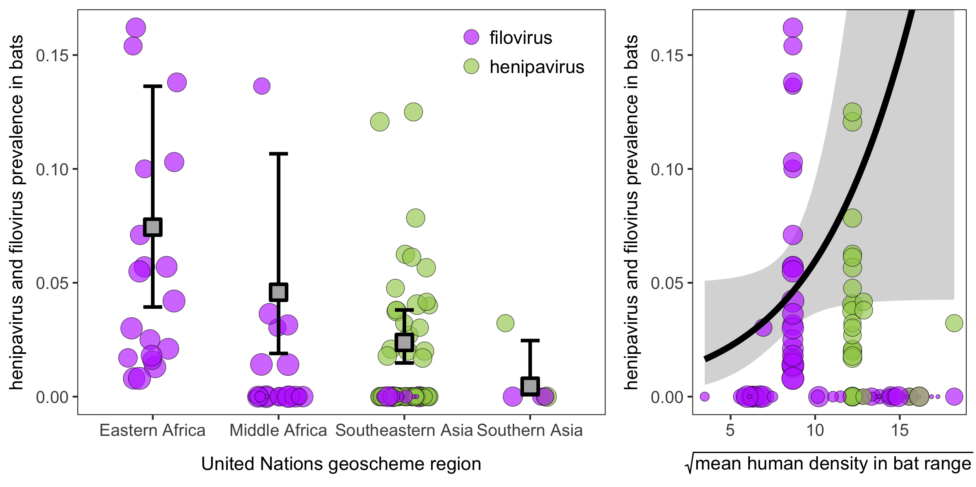
Fig 6/B.

Slide 7
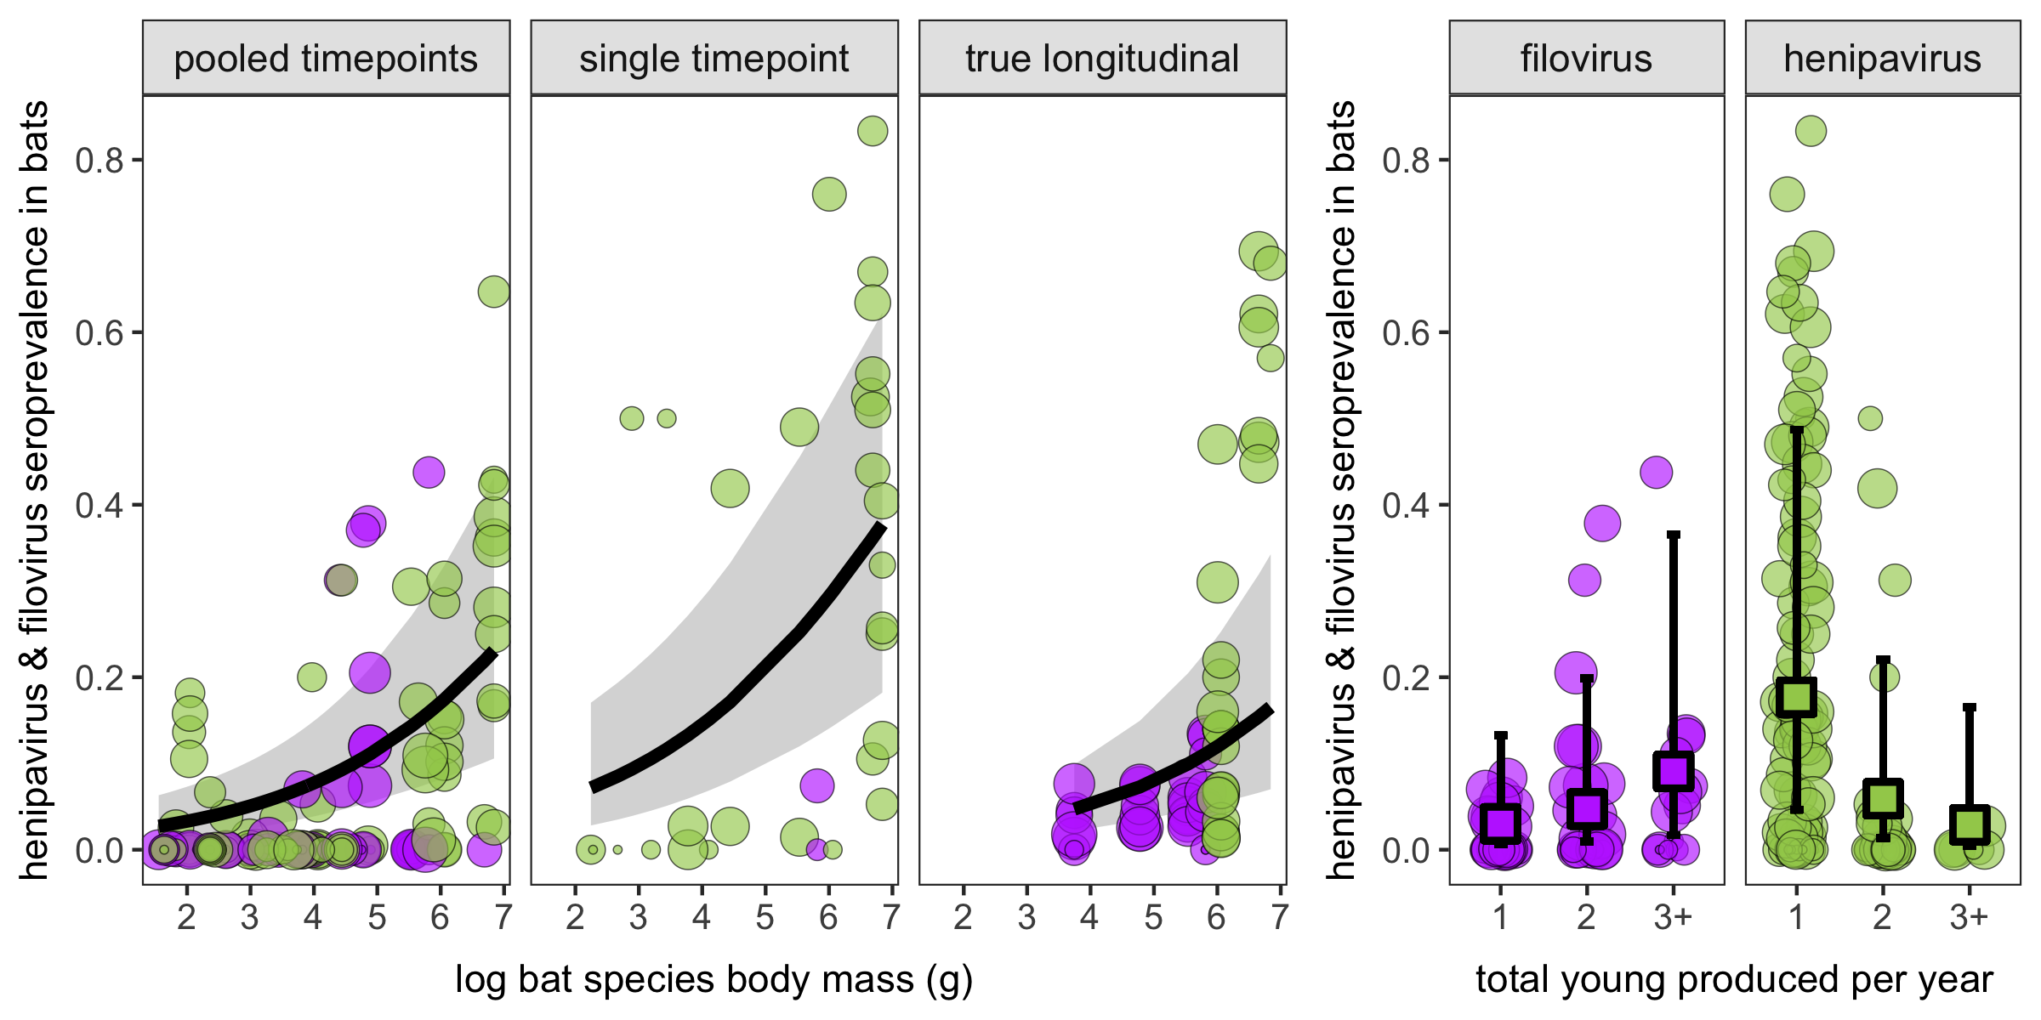
Fig 7/A.

Slide 8
A
Fig XX (alternative version). Sampling & Reporting Strategy
A. A schematic displaying a theoretical change in seroprevalence over the course of a year. Colored regions represent sampling schemes present in filovirus/henipavirus literature. B. Breakdown of sampling schemes present in literature. Includes mean time (in days) and standard deviation over which studies pooled multiple sampling events into single estimate.

